Slide 1
Chronic Kidney Disease Dataset Analysis
By: Sushruti Vasireddy, Grayson Grabois, Roschelle Dsouza, and Shiroz Kazani
Notes:
sushruti

Slide 2
Agenda
01
02
03
04
05
06
Company Introduction
The Clinical Problem
Our Objective
Reality of our Dataset
Individual Clinical Analyses
Recommendations/ Limitations
Notes:
Sushruti

Slide 3
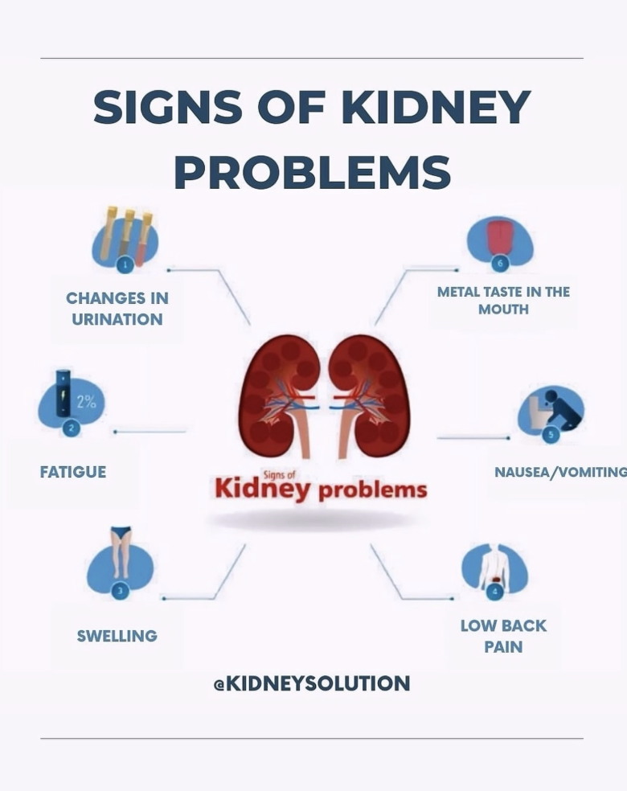
NephroAnalytics Group
Who We Are:
A data science consulting team specializing in early detection of chronic kidney disease using routine clinical data.
Our Mission:
Identify at-risk patients from existing lab work so they can receive care before CKD progresses to kidney failure.
The Team:
- Sushruti — Age Analysis
- Grayson — Blood Pressure Analysis
- Roschelle — Hemoglobin Analysis
- Shiroz — Glucose Analysis & Clinical Context
Notes:
Grayson
We are NephroAnalytics. We are an up and coming
Consulting team specializing in finding early onset
kidney disease from existing labwork. We are working to build
models to accurately predict if someone is likely to be
diagnosed with Kidney Disease from features like
their blood pressure and urine samples. We hope
to help those at risk start preventative care before its too late.

Slide 4

The Clinical Problem:Why Early CKD Detection Matters
CKD is a silent disease
Affects ~15% of U.S. adults
Most patients are asymptomatic until late stages
Late detection → dialysis, transplant, high mortality
The Challenge for Hospitals
CKD labs already exist in routine testing
But risk patterns are not clearly flagged
Early signals are being missed
The Business Problem
Late-stage CKD = high cost + preventable complications
Hospitals need a data-driven screening strategy

Slide 5

Our Objective
Identify which biomarkers best predict CKD
Assess data quality before modeling
Preserve clinical signal while cleaning messy data
Deliver actionable screening recommendations
Analyze 400 patient records from the UCI CKD dataset (via Kaggle), including key clinical and laboratory features
Question: Can routine lab data be leveraged to flag high-risk CKD patients earlier?

Slide 6
The Reality of Our Dataset
The Scale of the Problem
1,009 missing cells across 242 of 400 rows — more than half the dataset is incomplete in some way
Simply dropping incomplete rows leaves only 158 patients — not enough to train on
Why Simple Imputation Won't Work
Feature values differ significantly between CKD and non-CKD patients
Example: Blood Urea (bu) — CKD median is 53.0, non-CKD median is 33.0. Using one overall median blurs that gap entirely
Notes:
Sushruri
"Over half our rows had at least one missing value. Dropping them wasn't an option — we'd be left with 158 patients.
The key insight is that features don't behave the same across groups. Blood urea, for example, has a median of 53 in CKD patients and 33 in non-CKD. If you impute with one overall median, you're actively destroying the signal the model needs.
So we imputed by group — CKD rows get the CKD median, non-CKD rows get the non-CKD median. The result is 400 complete rows with the clinical differences preserved."
“This dataset had a serious missing data problem — 1,009 missing cells across 242 of the 400 patient records, meaning more than half were incomplete.
Simply dropping incomplete rows would leave us with only 158 patients, far too few to train a reliable model. And simple imputation — like using a single overall median — wouldn’t work either, because feature values differ significantly between CKD and non-CKD patients.
For example, Blood Urea: the median for CKD patients is 53.0, while for non-CKD patients it’s 33.0. Using one overall median would blur that difference and weaken the signal our model depends on.

Slide 7
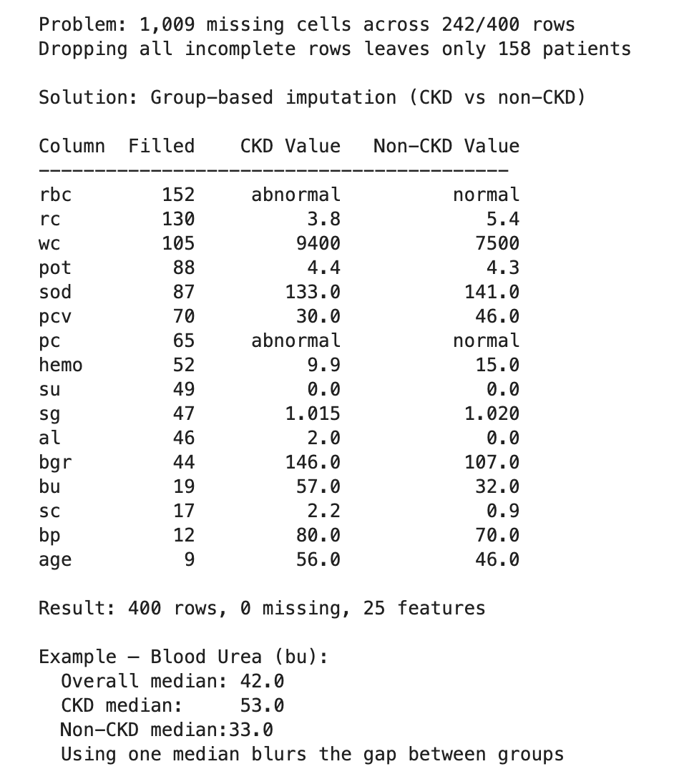
Missing Data Challenges
Missing Data — The Problem
1,009 missing cells across 242 of 400 rows — more than half the dataset touched by missing data
Why Group-Based Imputation
Feature values differ significantly between CKD and non-CKD patients, so a single overall median would blur the real clinical differences between groups
The Fix
Missing values filled using the median of CKD patients for CKD rows, and the non-CKD median for non-CKD rows — preserving the signal that matters
The Result
400 rows, 0 missing, 25 features — ready for classification
Notes:
Sushruti
Why Group-Based Imputation Works:
We fill CKD rows with the CKD median and non-CKD rows with the non-CKD median.
This preserves the true distribution of each group.
The differences between CKD and non-CKD patients remain intact, giving the model the signal it needs to separate the groups.
Clinical Rationale for Group-Based Imputation:
If we were to impute missing values using a single overall median, we’d artificially “normalize” CKD patient values toward the healthy population, masking clinically relevant abnormalities. Clinically, this is critical because predictive models are only useful if they reflect actual differences between diseased and healthy patients, rather than artifacts of how we handle missing data.
Step-by-step:
1️⃣ groupby('classification') Splits the data into two groups:
CKD
non-CKD
2️⃣ ['hemoglobin'] Focuses only on the hemoglobin column.
3️⃣ transform(...) Applies something to each group but keeps the dataframe the same size.
4️⃣ lambda x: x.fillna(x.median()) For each group:
Find that group’s median hemoglobin
Replace missing values in that group with that median

Slide 8
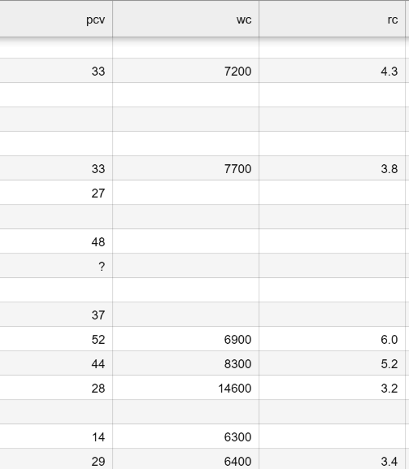
Data Type Corrections
Packed cell volume (PCV), White cell count (WC), Red blood cells (RC)
→ Numeric columns, but stored as objects.
Pandas to.numeric
Notes:
Roschelle

Slide 9
Inconsistent Classifications
Diabetes (dm)
Extra spaces
Classification
Extra tabs causing some cells to say ‘ckd\t’ instead of ‘ckd’ or ‘notckd’
str.strip()
Notes:
Roschelle

Slide 10
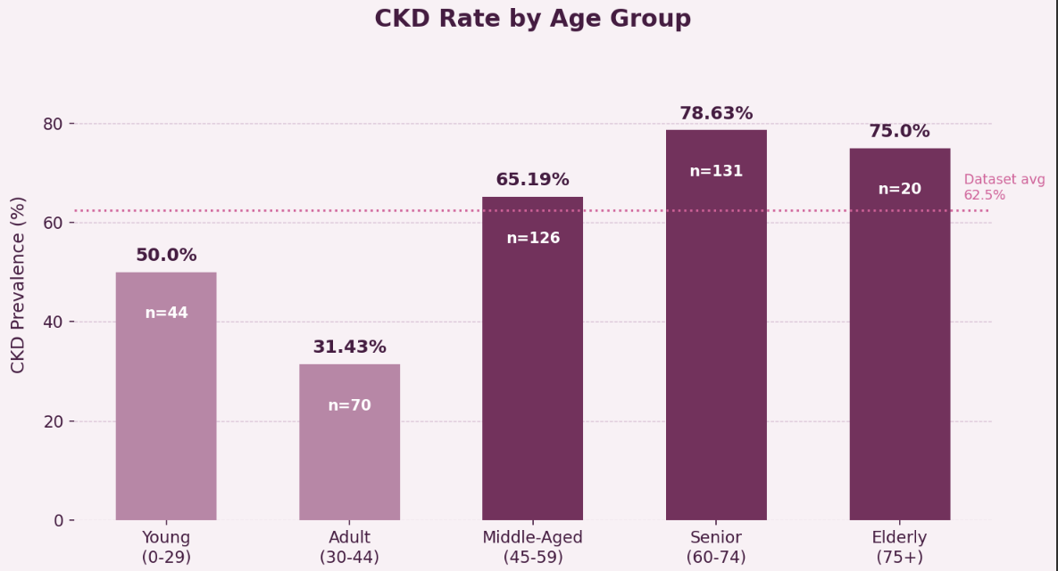
Age Analysis
Key findings:
Seniors (60–74) are the largest group (n=131) with the highest CKD rate at 78.6%
Sharpest rise occurs at age 45 — CKD rate more than doubles from 31% to 65%
Young patients (0–29) sit at 50% despite low risk — likely congenital causes
Elderly rate dips slightly to 75% — probable survivor bias
Notes:
“We calculated the age distribution and CKD rates using pandas. First, we categorized patients into age groups: Young (0–29), Adult (30–44), Middle-Aged (45–59), Senior (60–74), and Elderly (75+). Then, we used groupby on the age category and calculated counts and CKD percentages using value_counts and mean on the CKD column, since CKD was encoded as 1 for positive and 0 for negative. This allowed us to easily see both how many patients were in each age group and the proportion of CKD cases in each group.
Our dataset shows that most patients are middle-aged or older, with Seniors (60–74) being the largest group at 131 patients, followed by Middle-Aged adults (45–59) at 126. The youngest (0–29) and Elderly (75+) patients are underrepresented, with only 44 and 20 patients respectively. CKD rates rise sharply with age: Adults (30–44) have the lowest rate at 31.4%, more than doubling in the Middle-Aged group to 65.2%, and peaking among Seniors at 78.6%. Young patients show a 50% CKD rate, but this is likely skewed by the small sample size — a few congenital or genetic CKD cases can inflate the percentage, rather than reflecting a true population-level risk. Clinically, this pattern aligns with expectations: kidney function naturally declines by about 1 mL/min per year after age 40. The slight dip from Seniors to Elderly (78.6% → 75%) likely reflects survivor bias, where the sickest patients do not survive into the oldest age group.

Slide 11
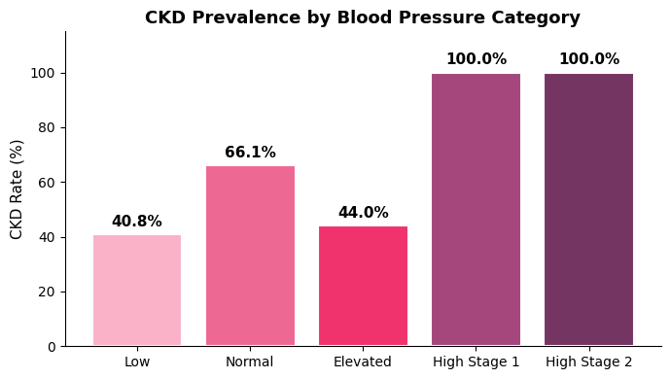
Blood Pressure Analysis
Key findings:
Every single patient with Stage 1 or Stage 2 hypertension had CKD.
The relationship is not perfectly linear (Normal 66% > Elevated 44%), which suggests other factors play a role.
Positive relationship overall from Low Blood Pressure Category to Hypertension
Notes:
Grayson

Slide 12
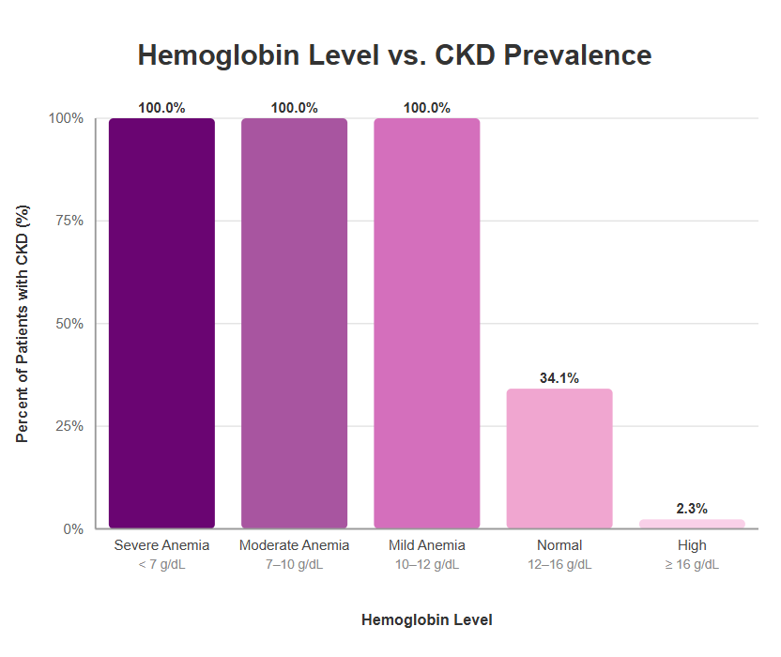
Hemoglobin Analysis
Key findings:
Severely low hemoglobin levels = patient isn't able to efficiently transfer oxygen
Low hemoglobin levels are associated with CKD prevalence
100% of patients in this dataset with Severe, Moderate, or Mild anemia have CKD

Slide 13
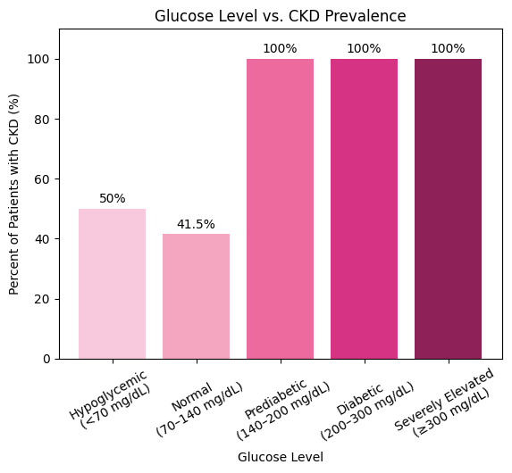
Glucose Analysis - Diabetes as a CKD Driver
Key Findings:
Diabetic-range glucose patients had the highest CKD prevalence
CKD rate increases across glycemic categories
Strong association between diabetes and kidney dysfunction
Clinical Interpretation:
Chronic hyperglycemia damages kidney filtration units
Diabetes is a primary upstream cause of CKD
Implication:
Elevated glucose should automatically trigger kidney function testing

Slide 14
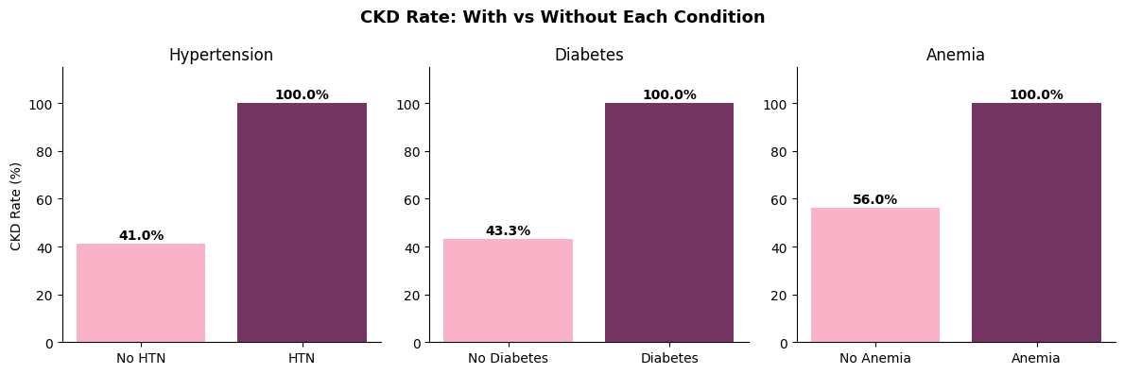
The CKD Triad
The CKD Feedback Cycle
Diabetes → CKD: Diabetes damages the kidney filters, leading to CKD
Hypertension → CKD: Hypertension damages kidney blood vessels, leading to CKD
CKD → Hypertension: CKD prevents removal of fluid, raising blood pressure
CKD → Anemia: CKD reduces erythropoietin, causing Anemia
Cycle effect: Diabetes and Hypertension drive CKD, and CKD reinforces Hypertension while causing Anemia. Anemia affects everything by delivering less oxygen to the organs.
Key Finding: High likelihood that if you have one of the 3 conditions, you are at risk or have the other 2
Notes:
Grayson
The CKD triad refers to the close relationship between
diabetes, hypertension, and chronic kidney disease. Diabetes and hypertension
both damage the kidneys—diabetes affects the kidney filters,
and hypertension damages kidney blood vessels.
Once CKD develops, the kidneys can’t remove fluid effectively,
which raises blood pressure and creates a feedback loop with hypertension.
CKD also reduces erythropoietin, leading to anemia, which means less oxygen
is delivered to organs which worsens all 3 conditions.
The key takeaway is that if someone has one of these conditions, they’re very likely
at risk for the others, which makes early detection critical.
100% of the patients who had diabetes OR hypertenstion
also tested postive for Chronic Kidney Disease.
We took the number of CKD patients in each group and divided it by the total
number of patients in that group. For example, with hypertension — there are
147 patients with hypertension, and 147 of them have CKD. 147 divided by 147
is 100%. For patients without hypertension, 103 out of 251 have CKD and 103
divided by 251 is 41%. The bar chart is showing a fraction turned
into a percentage for each group.
We wrote a function called ckd_rate_bar that takes in a column name, groups
patients by yes or no, calculates the CKD rate for each group, and plots it.
Then we just called it three times with different columns — htn, dm, ane —
instead of writing the same groupby and bar chart code three times.

Slide 15
Screening Recommendations
Screen patients with high blood pressure first: every patient with BP 90+ had CKD in our data
Check blood urea and creatinine alongside blood pressure — CKD patients had double the urea levels
Flag diabetic patients for kidney labs automatically
Track hemoglobin in CKD patients — drops may signal worsening
A binary classification model could automate all of this from routine lab work.
Notes:
Grayson
Our recommendations come down to using data that doctors are already
collecting. Blood pressure, blood urea, creatinine, glucose, hemoglobin —
these are all part of routine lab work. CKD screening is just a blood test and
a urine test. The problem isn't that the data doesn't exist, it's that no one
is connecting the dots automatically. Every patient with blood pressure over
90 in our dataset had CKD. Every diabetic patient had CKD. These are simple
flags that a binary classification model could catch from a standard lab panel
without a doctor having to manually review every result. That's what we're
proposing — not new tests, just smarter use of the tests that are already
being done."
How to Screen: 1. Blood test — checks creatinine levels to estimate how well your kidneys are
filtering (called GFR)
2. Urine test — checks for albumin (protein) leaking into urine, which means
the kidney filters are damaged
Both are part of routine lab work. That's the whole point of our project — the
data to catch CKD early already exists in standard bloodwork. A model just
needs to flag who's at risk.

Slide 16
Study Limitations
Imbalanced Dataset:
150 patients without CKD
250 patients with CKD
Data quality issues: ‘?’ or blank
Findings are strictly correlational, no causation
Notes:
roschelle

Slide 17
Final Takeaways
1. CKD rarely exists alone
Strong overlap with diabetes, hypertension, and anemia
2. Data quality determines model quality
1,009 missing cells required strategic imputation
Preserving group differences was critical
3. Screening Should Prioritize:
Hypertensive patients
Diabetic patients
Patients with dropping hemoglobin
4. Big Picture
Routine lab data can power early CKD detection, but only if cleaned and interpreted correctly.
Notes:
shiroz

Slide 18
Thank you
Questions?

